Slide 1
UIC railway Digital Platform Launch Conference
UIC HQ
Paris, November 30th 2015
Notes:
Jean-Pierre Loubinoux

Slide 2
AGENDA
General Introduction
Jean-Pierre Loubinoux, UIC
How Digital is Transforming our World ?
Yves Tyrode, UIC
Online Form Outcomes
Thierry Bera, UIC
Digital Benchmarks & Trends
Moundir Rachidi, The Boston Consulting Group
An Innovative Initiative: Hyperloop
Brogan Bambrogan, Hyperloop
Internet of Things: Connected Devices
Ludovic le Moan, Sigfox
UIC Digital Platform Presentation
Yves Tyrode & Jean-Pierre Loubinoux, UIC
Conclusions, Q&A

Slide 3
General Introduction Jean-Pierre Loubinoux, UIC
Notes:
Jean-Pierre Loubinoux

Slide 4
How Digital is Transforming our World ? Yves Tyrode, UIC Digital Community Chairman
Notes:
Jean-Pierre Loubinoux

Slide 5
Going digital is a deep Transformation
Digital is not taking "old" to make "new"!
It is often doing different tasks with new approaches and new tools

Slide 6
Digital transformation IN 4 dimensions
Technologies
Use cases
Business model
Methodologies

Slide 7
Multiple Performance IMPACTS enabled by digital
Transformation of the existing
Creation of new Business Models
Security
Management
Industrial
Client experience
Increase security thanks to anticipation of incidents, document access in mobility etc.
Simplification of tasks, real time data, focus on key tasks on field
Productivity increase on existing tasks, performance increase thanks to new uses
Improve client experience thanks to implementation of new services
Outlook towards new business horizon in a defensive or offensive logic
PROVED RESULTS IN DIFFERENT INDUSTRIES

Slide 8
Digital with impacts along all service and customer value chain
Digital platforms
Get travel inspiration
Big data
Personalized travel suggestions
Digital platforms
Single platform for planning
Cyber security
Guaranteed data confidentiality
Digital platforms
Share experience online
Contact
Inspiration/
desire to travel
Planning/ booking
Physical travel chain
After the trip
Share
Autonomous driving
Door-to-door
Connectivity
Stay connected all the journey
Digital platforms
Apps to navigate on-board and order food
Source: BCG analysis

Slide 9
Impacts along all steps of rail operations value chain
Industry 4.0
Crowd sourcing of engineering
Big data
Personalized suggestions
IoT – Internet of things
Real-time tracking
Industry 4.0
Predictive maintenance
Build tracks & infrastructure
Manufacture rolling stock
Marketing & sales
Operate network & logistics
Customer service
Maintenance
Autonomous driving
Driverless trucks
Big data
Improved forecast accuracy
Big data
Increased productivity
IoT
Condition monitoring systems
Cyber security
Data confidentiality & network safety
Source: BCG analysis

Slide 10
Major digitaltrends as KEY points for the Mobility industry
Connectivity
Continuous connectivity will become critical differentiator between travel modes
IoT – Internet of Things
Connecting different objects to the internet opens a wide array of possibilities (e.g. sensors)
Big data
Big data and analytics capabilities provide different possibilities in both operational and sales aspects
1
2
3
Digital platforms
On-going engagement with customers and communities, e.g., through online platforms
Industry 4.0
Applying new tech tools to improve productivity
Autonomous driving
Autonomous driving trends with potential to change underlying costs structure
4
5
6
Cyber security
Mobility, as other industries, becoming a target for cyber attacks
7
Source: BCG analysis

Slide 11
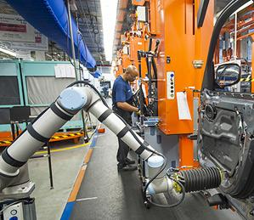
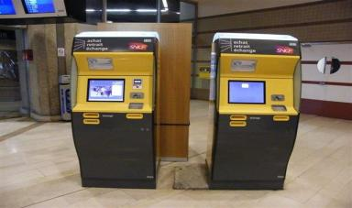
Why are we talking about digital now ?
Devices spreading
very fast
Technology costs dropping
Tech applications
easier to use
More mobile phones in 2014 then world population
Smart devices¹ of total mobile
devices will continue to rise
Mobile data traffic is now
the size of the entire global
internet in 2000
Independent robots as integral part of processes
Cost of sensors
$1.30
.60
avg. cost
over the past ten years
2014
2019
Smart devices
Machines for easy and fast ticketing
26%
Cost of bandwidth
74%
46%
54%
40x
Other devices
30x
over the past ten years
1. Smart Devices: mobile connections that have advanced multi-media/computing capabilities with a minimum of 3G connectivity
Source: BCG analysis; Cisco Visual Networking Index: Global Mobile Data Traffic Forecast Update, 2014-2019

Slide 12
Online Form Outcomes Thierry Bera, UIC
Notes:
Jean-Pierre Loubinoux

Slide 13
ONLINE FORM: Key Outcomes
4 themes about the digital issues
16 questions
5 key outcomes based on your feedbacks

Slide 14
Online form: Survey Results
OUTCOME #1
“Innovation Booster”
The digital is perceived as the way to :
Innovate
Enhance CRM (e-ticketing, onboard Internet connexion…) & cost management
Create new habit patterns for staff and for business customers by using new connected technologies
Notes:
Thierry Bera

Slide 15
Online form: Survey Results
Notes:
Thierry Bera

Slide 16
Online form: Survey Results
OUTCOME #2
Digital Transformation / Internal Organization :
Most of companies are conscious about the digital impact & the transformation that these technologies have created in our consumer habits
Few of the internal organizations include the digital/prototyping cluster or dedicated teams
Notes:
Thierry Bera

Slide 17
Online form: Survey Results
OUTCOME #3
Smartphone Apps & Social Media are 2 main appropriated /developed digital supports:
Internal use & customer focused apps
Facebook, Google +, Twitter community management
Notes:
Thierry Bera

Slide 18
Online form: Survey Results
OUTCOME #4
The digital is more than communication tool:
The digital technologies are identified as contributing to the new generation of R&D applied to the railway area
Notes:
Thierry Bera

Slide 19
Online form : Survey Results
OUTCOME #5
The most relevant project themes:
Notes:
Thierry Bera

Slide 20
Online form : Survey Results
CONCLUSIONS
Unmet needs & resources:
44% of the companies have not yet experienced such digital development tools as apps
1 out of 2 companies do not use any reliability equipment or maintenance optimisation system
Near 2/3 of companies do not have an internal Digital Chief Officer position
The digital skills, when unavailable internally, should be met through the UIC Collaborative Digital Plateform for sharing ideas & prototyping
Notes:
Thierry Bera

Slide 21
Digital Benchmarks & Trends Moundir Rachidi, The Boston Consulting Group
Notes:
Jean-Pierre Loubinoux

Slide 22
Passenger satisfaction can be improved through continuous connectivity
1
Connectivity
Wi-Fi biggest service gap for travelers
Wide differentiation of connectivity
% Passengers who value the service
Wi-Fi available even at low cost operators
% Passengers received the service
Bus
Wi-Fi connection
-63%
F&B experience
Free connection
Paid connection
Wayfinding experience
Air
Friendly staffs
Short waiting time
to receive service
Access to necessary
amenities
Only limited availability of connectivity throughout customer journey
Shopping experience
Rail
Source: BCG Survey 2015 – Business travelers; Companies websites

Slide 23
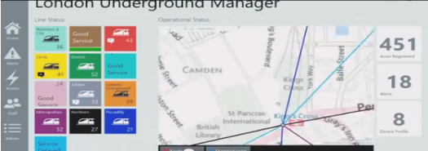
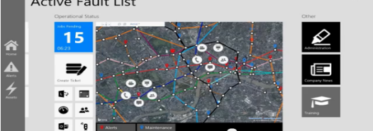
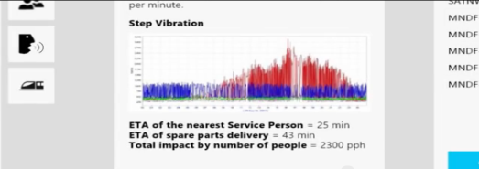
Improved maintenance and reduced costs using Internet of Things
2
IoT – Internet of Things
Modernizing systems that monitor critical assets using data from sensors and intelligent devices
Generating system alerts
Integrating and automating disconnected systems
Streamlining manual monitoring processes
Spotting equipment degradation in real time and measuring asset performance
Video link
Source: BCG Survey 2015 – Business travelers; Companies websites
Notes:
En doublon Ludovic Le Moan

Slide 24
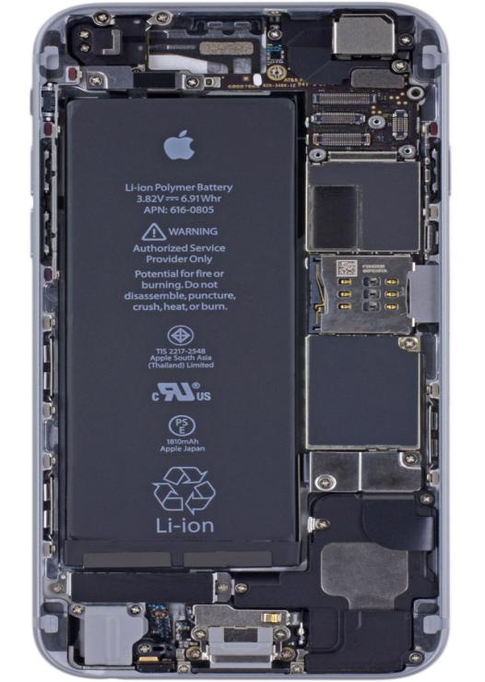
IoT already in your pockets !
2
IoT – Internet of Things
iPhone sensors
3-axis gyroscope
Ambient light sensor
Barometer
Compass
FaceTime HD camera
Force touch sensor
GPS
iSight 8-megapixel camera
Microphone
Motion sensor/accelerometer
Moisture sensor
Proximity sensor
Touch ID
And via Apple Watch…
Barometer
Force touch
Infrared heart monitor
Microphone
Visible light heart monitor
Source: BCG Survey 2015 – Business travelers; Companies websites

Slide 25
Proximity, gyro, heartbeat, gas, light, tilt, sound, temp, IR, radiation…
2
IoT – Internet of Things
Average sensor cost trend 2004-2020
$1.30
$0.38
Source: BCG Survey 2015 – Business travelers; Companies websites
Notes:
Cf slides conclusion

Slide 26
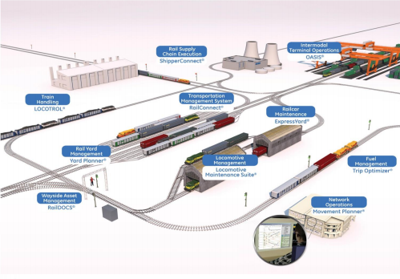
Value creation using Big Data
3
Big data
Capacity utilization improvements for cargo transport
Improved daily railway operations
Transmetrics software combines historical shipping data from client operational shipping systems with external databases
(e.g. public holidays, weather, product launches, etc.)
The RailConnectTM System offers mission-critical rail transportation management:
Eliminates manual processing
Improves information flow
Increases productivity
Reduces costs
Video link
Source: BCG Survey 2015 – Business travelers; Companies websites
Source: Company website

Slide 27
Value creation using Big Data in railways
3
Big data
Source: BCG Survey 2015 – Business travelers; Companies websites
Source: Company website

Slide 28
Big data waiting for you
3
Big data
2011
The world’s stock of data 1986-2020
2007
Analogue 18.86 x 10¹⁸ Bytes (B GB)
CDs
Analogue
(Paper, film audiotape, vinyl)
DVD/Blu-Ray
1986: 2.62 x 10¹⁸ Bytes (B GB)
2000
1986
1993
Digital tape
Connected via IP protocol
Servers
Digital
35 x 10²¹ Bytes (35 Zettabytes) by 2020?
Digital 276 x 10¹⁸ Bytes (B GB)
(In 1986, principally pocket calculators)
1986: 0.02 x 10¹⁸ Bytes (B GB)
(IDC estimate)
PC Storage
Notes:
Explication trop technique et chronophage pour un public non expert

Slide 29
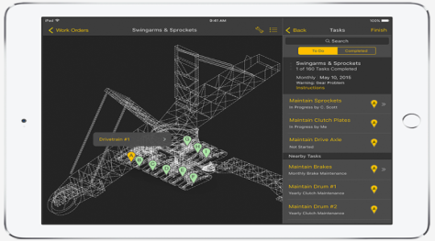
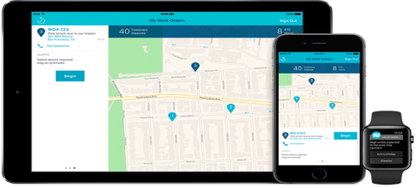
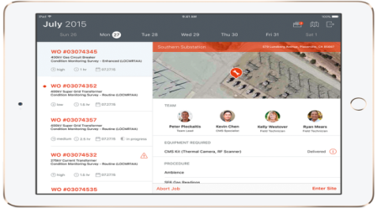
Improved productivity of field employees using digital platforms
4
Digital platforms
Example: IBM & Apple launched an app empowering utility employees that work in the field
Asset Care
Offers optimized schedule of work orders and preventive maintenance
Field Connect
Online access to different systems (geographic information, outage mgmt., work order mgmt.)
Asset Inspect
On-field use of predictive analytics-driven "most likely cause" scenarios with recommended course of action
Source: Company website

Slide 30
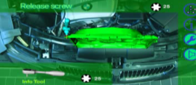
Transformed industrial operations
5
Industry 4.0
Augmented reality
Autonomous Robots
Augmented reality glasses for repairs and maintenance activities
Autonomous robots for faster, more precise manufacturing
Video
link
Industry
4.0
Additive manufacturing/ 3D printing
Simulation
Using additive manufacturing to produce tools and final components
Upfront optimization of factory processes to reduce cost and speed up time to market
Source: BCG
Source: BCG

Slide 31
Example of augmented reality
5
Industry 4.0

Slide 32
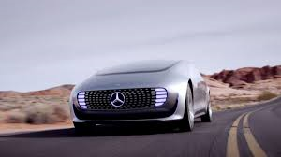
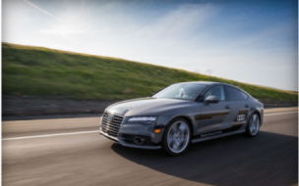
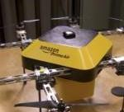
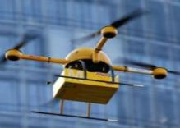
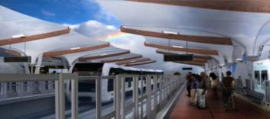
Autonomous vehicles becoming a reality and introducing a new way of transportation
6
Autonomous driving
Car
Car
Truck
Mercedes F015 autonomous pilot
Audi A7 autonomous highway pilot
Freightliner Inspiration Truck
Truck
Air
Air
Mercedes Future Truck 2025
Amazon delivery drones
DHL Parcelcopter
Rail
Rail
Rail
Honolulu Driverless Transit System
AnsaldoBreda Driverless Metro in Copenhagen
Siemens Trainguard
Source: Press articles, BCG research

Slide 33
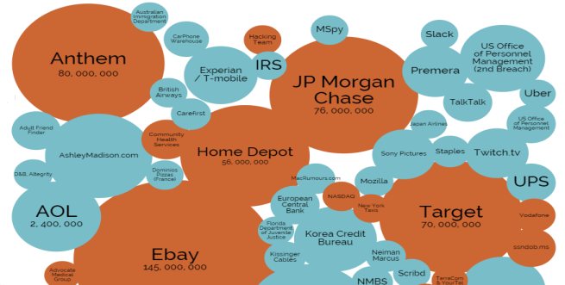
Improving cyber security capabilities will be a must for all companies in Mobility
7
Cyber security
Cyber Security market continue to grow to deal with increasing threats
Biggest data breaches since 2014
Market size $B
+10%
Across industries¹
Theft of 750K frequent flyer members' data
2015
2016e
2017e
2018e
2019e
2020e
173M taxi journeys' data released (Incl. driver ID, route & time)
Mobility
Customers' data from Belgium, France and UK was breached (1.4M records Incl. name, gender, DOB, email and postal address)
1. Bubble size represents # of records reported stolen in publicly acknowledged breaches
Source: Markets and Markets; www.informationisbeautiful.net

Slide 34
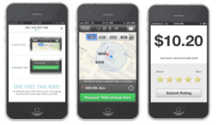
New business models appearing in many industries thanks to digital
The world's largest accommodation provider owns no real estate
New mobility business model
No assets
Drivers use own car
No need for Call Center
Mobile phone used for booking and communications
No driver maps training required
Drivers mandatory use of GPS
✗
The most valuable retailer has no inventory
✗
✗
The world's most popular media owner, creates no content
Operates in 64 countries, more than 160K drivers and estimated at ~$50B
What’s next in railways with digital ?
Source: Company website; Press release

Slide 35
How to PERFORM with digital ?
 | Be customer focused | Continuously interact and learn from customers Solve customers' pain points
 | Think like a Venture Capitalist (test solutions) | Launch pilots Quickly determine whether worth it – if not, stop
 | Transform org. culture | Be ready to fail and learn from failure Think in weeks, not only in years
 | Build capabilities | Retain and recruit top talent experienced with digital innovation Empower small teams to test ideas
 | Develop an Ecosystem | Create partnerships within the industry and beyond

Slide 36
Example of an Innovative Initiative: Hyperloop Brogan Bambrogan, Hyperloop
Notes:
Jean-Pierre Loubinoux

Slide 37
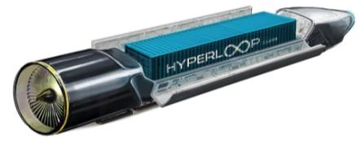
Video link

Slide 39
1

Slide 40
2

Slide 41
3

Slide 42
4

Slide 43
5

Slide 44
Internet of THINGS: Connected Devices Ludovic le Moan, Sigfox
Notes:
Jean-Pierre Loubinoux

Slide 45
What are the connected devices today ?

Slide 46
Example of augmented reality

Slide 47
Example of augmented reality

Slide 48
UIC Digital Platform Presentation Yves Tyrode & Jean-Pierre Loubinoux, UIC
Notes:
Jean-Pierre Loubinoux

Slide 49
To deal with digital transformation we are launching a Digital Platform
PLATFORM OBJECTIVES:
#1 - Encourage sharing best practices within the railway community
#2 - Connect members with external digital ecosystem, where innovation currently happens
#3 - Experiment in a open source model since we want this platform to be community driven
The UIC Digital Platform will support & assist members in the implementation of their projects from the idea to the POC execution, leveraging the digital community

Slide 50
6 STRATEGIC UIC Digital Platform ORIENTATIONS
Data
Passenger experience
Connectivity along the travel path
IoT – Maintenance 4.0
Freight 4.0
Cyber security
1
2
3
4
5
6

Slide 51
UIC Digital Platform "Share, Connect, Open" to face digital transformation
Next steps
Create a community platform to share ideas & make the concepts real (POC execution)
Build a "marketplace" to connect with the competitive start-ups & other digital key players (associations, coworking places, think tanks etc)
Launch a "start up challenge" initiative
Select relevant initiatives topics & invite members to join the challenge
Timing
Digital Platform meetings coming next:
- Q1 2016 : Start-up challenge kick-off
- Q3 2016 : Jury & “Best in class” vote
- Q4 2016: Best POC pitchs presentations & winners celebration in December 2016 in St Petersbourg
Please connect to : https://www.facebook.com/UICDIGITAL

Slide 52
Questions & ANSWERS
UIC HQ
Paris, November 30th 2015
Notes:
Jean-Pierre Loubinoux

Slide 53
Conclusions
UIC HQ
Paris, November 30th 2015
Notes:
Jean-Pierre Loubinoux

Slide 54
Thank you
UIC HQ
Paris, November 30th 2015
Notes:
Jean-Pierre Loubinoux

